Slide 1
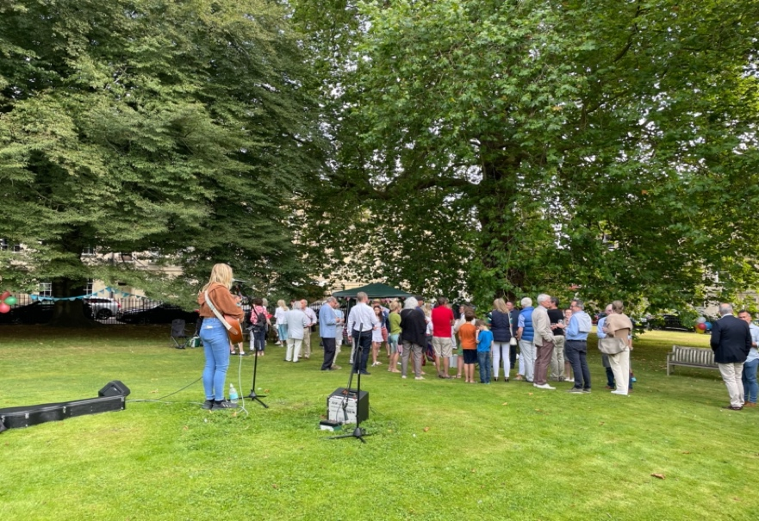
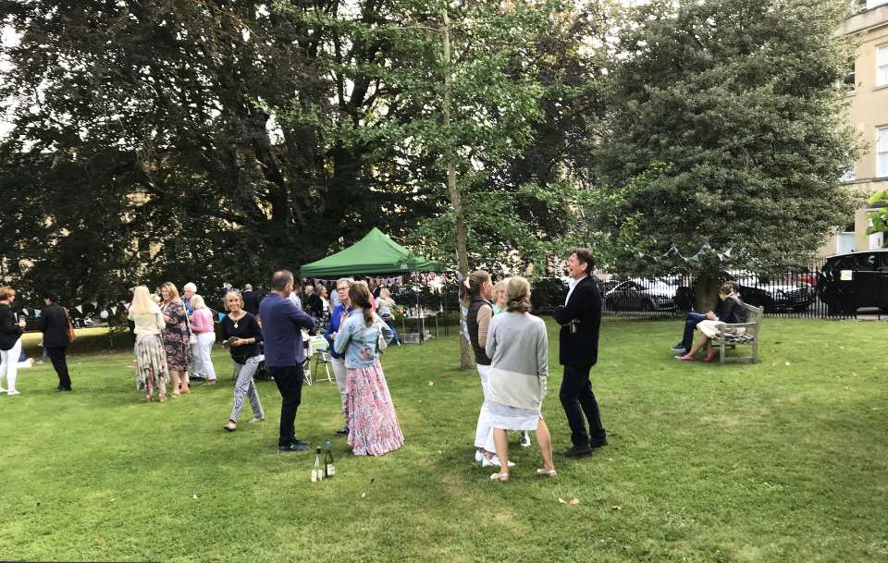
St James’s Square News
Keeping our residents up to date…
Issue No. 4 November 2021
Dear St James’s Square Residents
Summer Garden Party
When we wrote our last newsletter in May, planning was underway for the Summer Garden Party which was due to be held in late June. As you all know, we sadly had to postpone that date due to Covid restrictions. The actual Garden Party took place on the 11th September and what a wonderful event it was! The weather gods obliged, the Garden looked magnificent, and the entertainment was fantastic. Thank you to all residents who came out to enjoy the party - it was our best turnout yet! A special thank you to Tom and Colyn Moore for their hard work in organising the event, booking the entertainment, hanging up the bunting and balloons, and making the day so special for St James’s Square residents, their families and friends. The 2022 Summer Garden Party is tentatively booked for Saturday, 2nd July…
St James’s Square Bath Limited 2021 AGM
The St James’s Square Bath Limited 2021 AGM will be held on Wednesday, 17th November at 6pm. While we were hoping to hold this in person at the St James Wine Vaults, we have made the decision to move this to a Zoom meeting instead due to the high number of Covid cases currently circulating in Bath. You should have received an email with the Zoom link and other details, but if not and if you are a resident and would like to attend, please email Sylvia Sinclair, secretary of St James’s Square Bath Limited on info@sjsbath.co.uk
Directors
St James’s Square Bath Limited
Wednesday, 17th November
St James’s Square Bath Limited AGM 6pm via Zoom
Sunday, 12th December
Litter Pick, meet in the western gate at 10am
Sunday, 13th March
Litter Pick, meet at the western gate at 10am
Sunday 29th May
Litter Pick, meet at the western gate at 10am

Slide 2
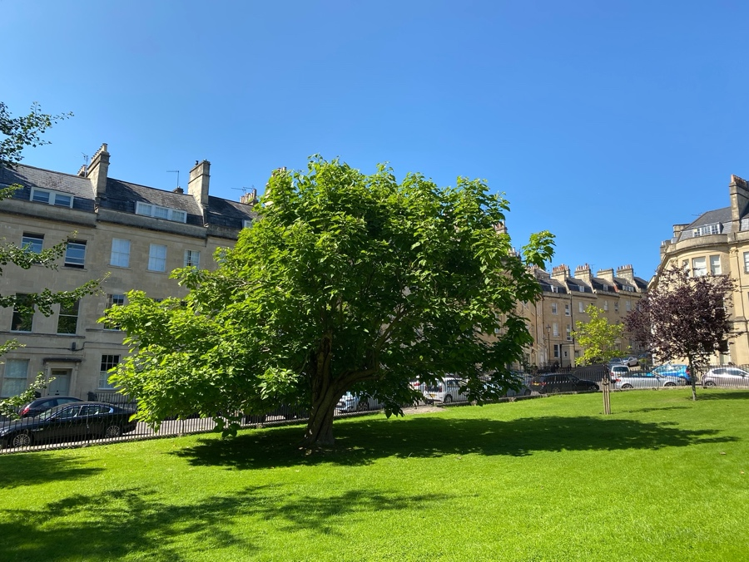
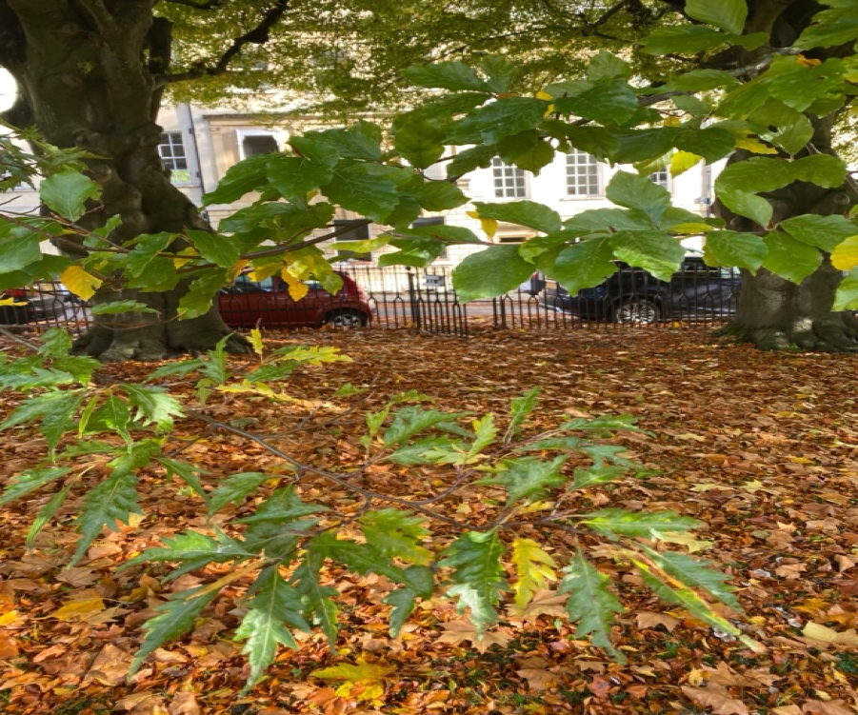
St James’s Square Garden Update
Garden
By mid November, I will have planted about 650 bulbs and 100 rhizomes in the St James’s Square Garden. They are mostly under the tree canopies in order to provide interest and colour in the spring before the trees come back into leaf. I am trying several different types and look forward to seeing what works well that could be increased in years to come to provide a wider carpet of flowers.
Apart from planting wild tulips under the Tulip tree at the top of the Garden, I shall also be planting some wildflower seeds – mainly oxeye daisies and red poppies to see if it is possible to create more of a wildflower meadow look without having to remove all the grass.
Trees
The Catalpa has looked very good this year and I have asked permission from the Council to be able to prune more branches to reduce the weight burden on the trunk. I have also asked for permission to cut back the small overhanging branches on most of the other trees to take them above head height.
As a matter of curiosity, the two Fern- leaved Beech trees on the Eastern side of the Garden, have, over time, reverted to their rootstock of the Common Beech – hence the mix of leaves on the same tree. (See photo).
Vicky Clarke – Director Garden/Trees
Catalpa Tree
Website & Social Media
New Website, Email & Social Media Accounts
St James’s Square Bath Limited has moved into the 21st Century with a new website, a new email address and new social media accounts!
Please add the new SJS Bath email address to your list of contacts (so that our emails do not end up in your junk box!) and follow us on Twitter and Instagram.
The website has been relaunched on a new platform and has general information about the Square, its history, news and events and some background of St James’s Square Bath Limited. The new website has a password protected Members Area where the Garden Gate Code and other key details like the Company’s finances are held. Tenants – you will continue to be provided the Garden gate code by your landlords but please do check out the website and follow us on Twitter and Instagram.
Please keep this password confidential and, as always, please do not provide the Garden gate code to non-residents.
We will continue to use email for key SJS Bath Limited updates. We will also now use Twitter for more general information as well as sharing local news and other news items that might be of interest to you. We will post photos of the Garden, the Square etc on Twitter and Instagram so please share any photos of the Square with us and we will happily post them. Details of the new accounts are as follows:
Website: www.sjsbath.co.uk
Email: info@sjsbath.co.uk
Twitter: @stjamesssqbath
Instagram: stjamesssquarebath
St James’s Square Bath Limited www.sjsbath.co.uk

Slide 3
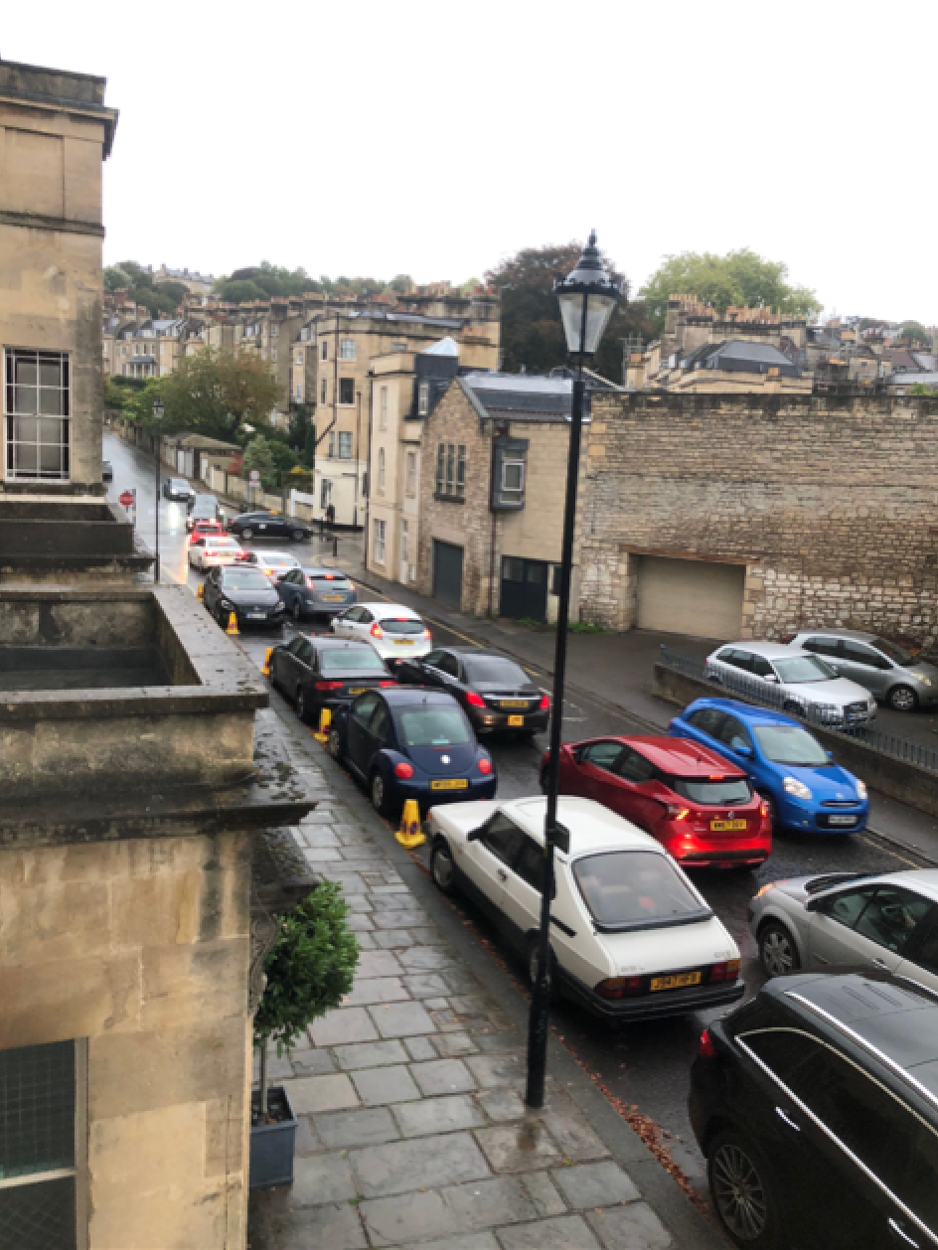
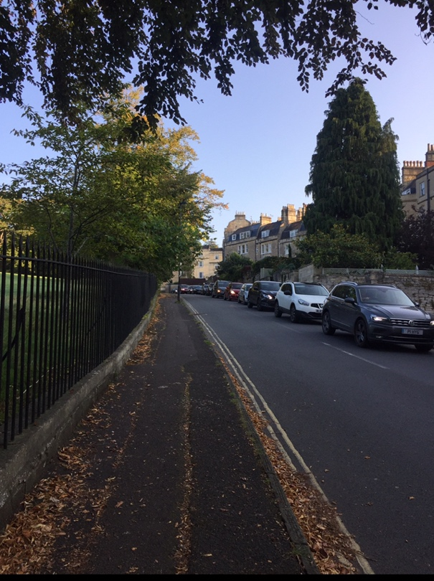
Important Local Information
Low Traffic Neighbourhood (LTN) Planning
You may have seen in the local press that the lower Lansdown area (including Cavendish Road/Winifred’s Lane/Lansdown Crescent) has been grouped together with the Circus area and Marlborough Buildings into a larger ”cell” for LTN planning.
This area has been shortlisted to be considered for the Council’s first round of LTN planning. We will learn more about the consultation and engagement process and plans in the next month.
The Council has correctly identified that the wider area needs to be considered so that we do not have displacement from one scheme into other neighbouring residential streets.
Queen Square Traffic Displacement
We are encouraged that the Council has been conducting official traffic monitoring of the impact the new Queen Square traffic light system is having on traffic volumes (and speeding traffic) using Marlborough Buildings and Cavendish Road as a route north from the city.
This monitoring will inform the Highways’s team of the right mitigation that our entire area requires to calm the through traffic and return the residential streets to previous levels.
We will continue to work with our ward Councillors on traffic issues in our surrounding streets and will keep residents updated.
Traffic queuing on Marlborough Buildings
Traffic queuing on Cavendish Road
Resident’s Parking Zone (RPZ) Changes
The Council is currently in its final stage of consultation on proposals for changes to on-street residential parking throughout the city. A couple of key things that we would highlight that will result from the RPZ changes if they are implemented:
Hotels who reside in Central Zone will no longer be able to valet park their guests’ cars in Zone 7. This will hopefully free up precious spaces in St James’s Square for residents as we often see the Royal Crescent Hotel in particular valet parking their guests’ cars in our Square and often for days at a time.
RPZ 7 (our zone) will include Sundays from 8am – 6pm.
The price of residents parking permits will be linked to car emissions.
The price of guest parking permits will increase by 50p/day in year 1, followed by subsequent increases of 25p/day in years 2 and 3.
Sion Hill Bath Campus Site Redevelopment
We recently wrote to you to highlight that the Sion Hill Bath Spa University Campus has been included in the Council’s Local Plan Partial Update (LPPU) and will be subject to a change in use to residential development. SJS Bath Limited directors, together with our neighbouring RAs, have issues with some of the aspects proposed in the LPPU with regards to this site and formally objected in the public consultation which closed last month. While much of the plan for the Sion Hill campus is positive, for example the protection of the parkland and the opening of public pedestrian pathways across the site (including a new pathway inside the site and running alongside of Winifred’s Lane), the increase in units from 60 (as originally proposed) to 100 is of concern. We specifically questioned the impact of 100 dwellings would have on our local residential streets which are experiencing increased volumes and speeds from rat running traffic. 100 dwellings could bring 150-200 more cars to our roads (especially worrying given that Sion Hill has no Resident Parking Zone).
St James’s Square Bath Limited www.sjsbath.co.uk

Slide 4
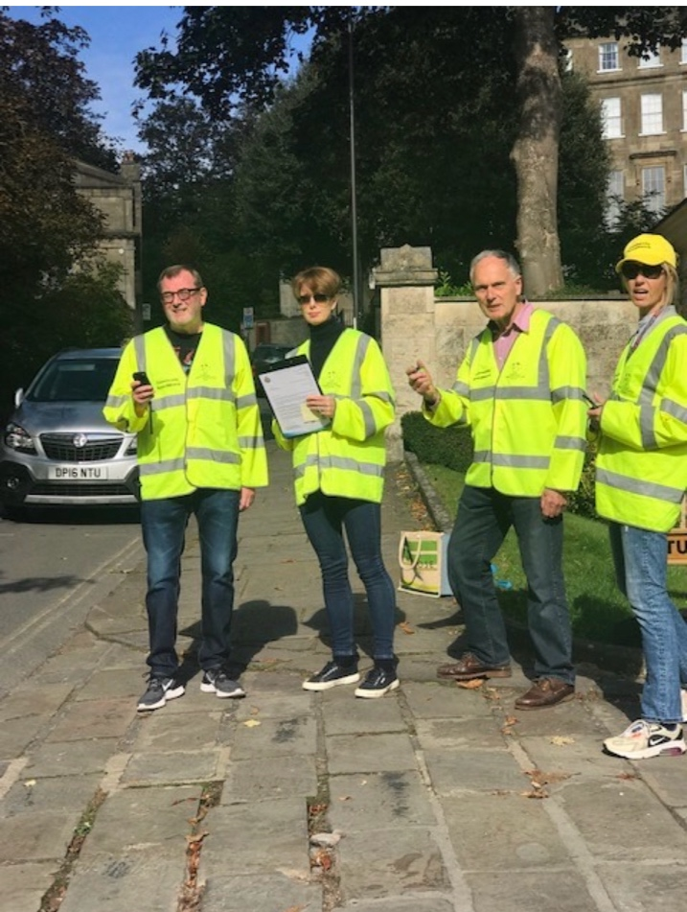
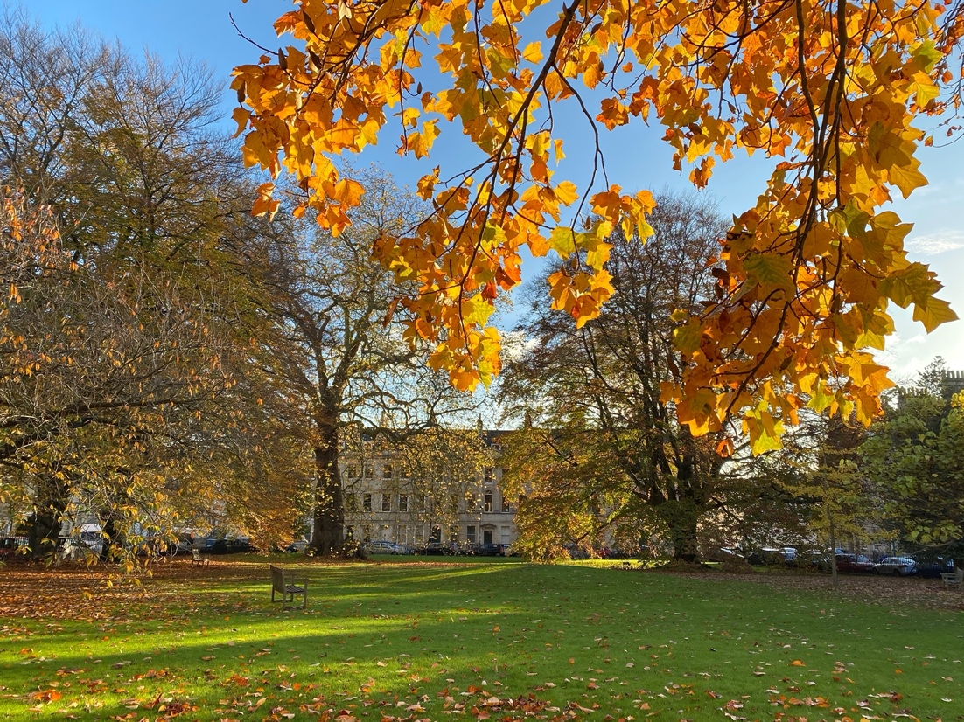
Important Local Information continued
Community Speed Watch
You may have seen volunteers in yellow vests on Cavendish Road and Winifred’s Lane with a clip board, a clicker and a small hand-held speed detection device. This is the new Community Speed Watch (CSW) team who are working with the police to help calm traffic on these two busy and dangerous residential roads.
Traffic volumes on Cavendish Road, Winifred’s Lane and Marlborough Buildings have significantly worsened since the CAZ traffic lights were turned on at Queen Square. The CSW team regularly capture volume data of 600+ vehicles per hour using Cavendish Road (between the times of 3.30pm – 6.30pm). A significant proportion of this traffic is travelling at unsafe speeds and together with the already dangerous intersection at the Marlborough Tavern, this is something we are eager for the Council to tackle.
Marlborough Buildings residents are also very concerned with traffic volumes and speeding traffic on their street (with a child recently hit at the Royal Avenue junction) and are currently working with police to establish a second team to monitor Marlborough Buildings.
The Council pledged to provide mitigation should any residential areas see displaced traffic and/or increased nitrogen dioxide levels from the Queen Square CAZ interventions and while we await some form of mitigation, the Community Speed Watch team will continue their efforts to help make these roads safer.
Community Speed Watch volunteers are fully trained and fully comply with police guidelines and data privacy requirements. Vehicles travelling 25mph or faster on these 20mph roads will be sent a cautionary letter from the Police but do not receive a speeding fine.
If you would like to volunteer for this team, please email Sylvia Sinclair on info@sjsbath.co.uk.
Zoom Update with Cllr Lucy Hodge
Lansdown ward Councillor Lucy Hodge was hoping to attend the second part of our upcoming AGM so that she could update residents on some of the important local issues that are highlighted in this newsletter.
Unfortunately, Lucy is no longer available on the evening of our AGM, and we are looking for another date when she, and possibly a Cabinet member, will be available to meet with St James’s Square residents on a Zoom call.
We will let you know when this Zoom call has been arranged, so please look out for emails on this. If you are especially interested in attending, please email Sylvia on info@sjsbath.co.uk and she will send you the Zoom link.
Some of the topics Lucy will update residents on include:
Low Traffic Neighbourhood planning update
Sion Hill Campus Residential development
Traffic issues/displacement of traffic to our area
Other issues that residents would like to discuss.
St James’s Square Bath Limited www.sjsbath.co.uk

