Slide 1
St James’s Square News
Keeping our residents up to date…
Issue No. 5 March 2022
Dear St James’s Square Residents
We are excited to let you know of the following events that we have planned in the garden over the coming months.
Easter Egg Hunt – Easter Sunday, 17th April @ 10am
This is one for all the children in the Square (and any visiting grandchildren!). We are planning an Easter egg hunt in the garden on Easter Sunday as well as a pre Easter Sunday competition! So that we have some idea of numbers, can all families interested please email our social director, Colyn Moore, at tomcolynmoore@hotmail.com. All children in the Square and visiting grandchildren are most welcome!
Queen’s Platinum Jubilee Celebrations – Friday, 3rd June @ 2pm onwards
While we are not planning anything formal for the Queen’s Platinum Jubilee weekend, with our summer garden party planned for July, we would invite all residents, friends and family to celebrate this wonderful occasion in the garden on Friday, 3rd from 2pm onwards. We will be putting up bunting to make the Square and garden festive and we invite you to bring your picnics out and enjoy the atmosphere!
St James’s Square Summer Garden Party – Saturday, 2nd July @ 3pm onwards
Early notice for our 2022 Summer Garden Party. After what was a fantastic garden party in September 2021, we are excited to let residents know that planning is well underway for this year’s garden party and it is sure to be another wonderful event!
IMPORTANT UPDATE ON THE FUTURE OF THE HIGH COMMON
The Council is, once again, in the process of looking for a commercial golf provider to return golf to the High Common. They are currently agreeing the process and timing, with the next stage being some market engagement, before a procurement process commences. While the Council has told us that their intention is to retain the High Common as a “flexible open space, open to the different users that currently enjoy the space”, our concern is that returning golf to this iconic and much loved ”Common” will in fact exclude all other uses and users who now enjoy the space for dog walking, picnicking, playing with children, reading, yoga, Nordic walking, etc. It is impossible for people to sit on the Common, play with children, dogs etc while golf balls are flying around. When we surveyed our membership in April 2021, it was clear that the very large majority of you would prefer the 18 hole (the side closest to Cavendish Road) to remain as parkland, while those happy for pitch & put golf to return, felt that this would be best suited on the 12 hole (below the allotments). Residents are strongly encouraged to email our ward Councillors, Lucy Hodge and Mark Elliott with their concerns about golf returning to the High Common and all other uses being effectively excluded. Their email addresses are: Lucy_Hodge@bathnes.gov.uk and Mark_Elliott@bathnes.gov.uk
Sunday, 17th April
Easter Egg Hunt, Garden @ 10am
Sunday, 29th May
Litter Pick, meet in the western gate @ 10am
Friday, 3rd June
Queen’s Platinum Jubilee, Garden from 2pm onwards
Saturday, 2nd July
St James’s Square Summer Garden Party, Garden from 3pm onwards

Slide 2
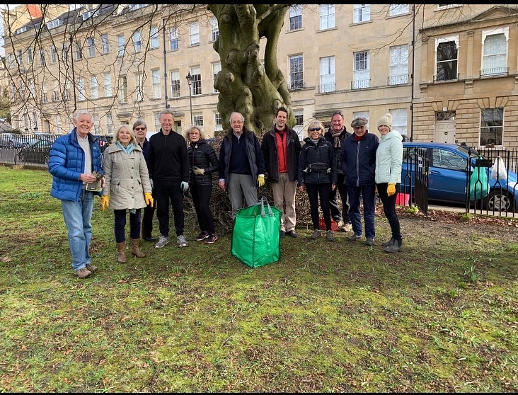
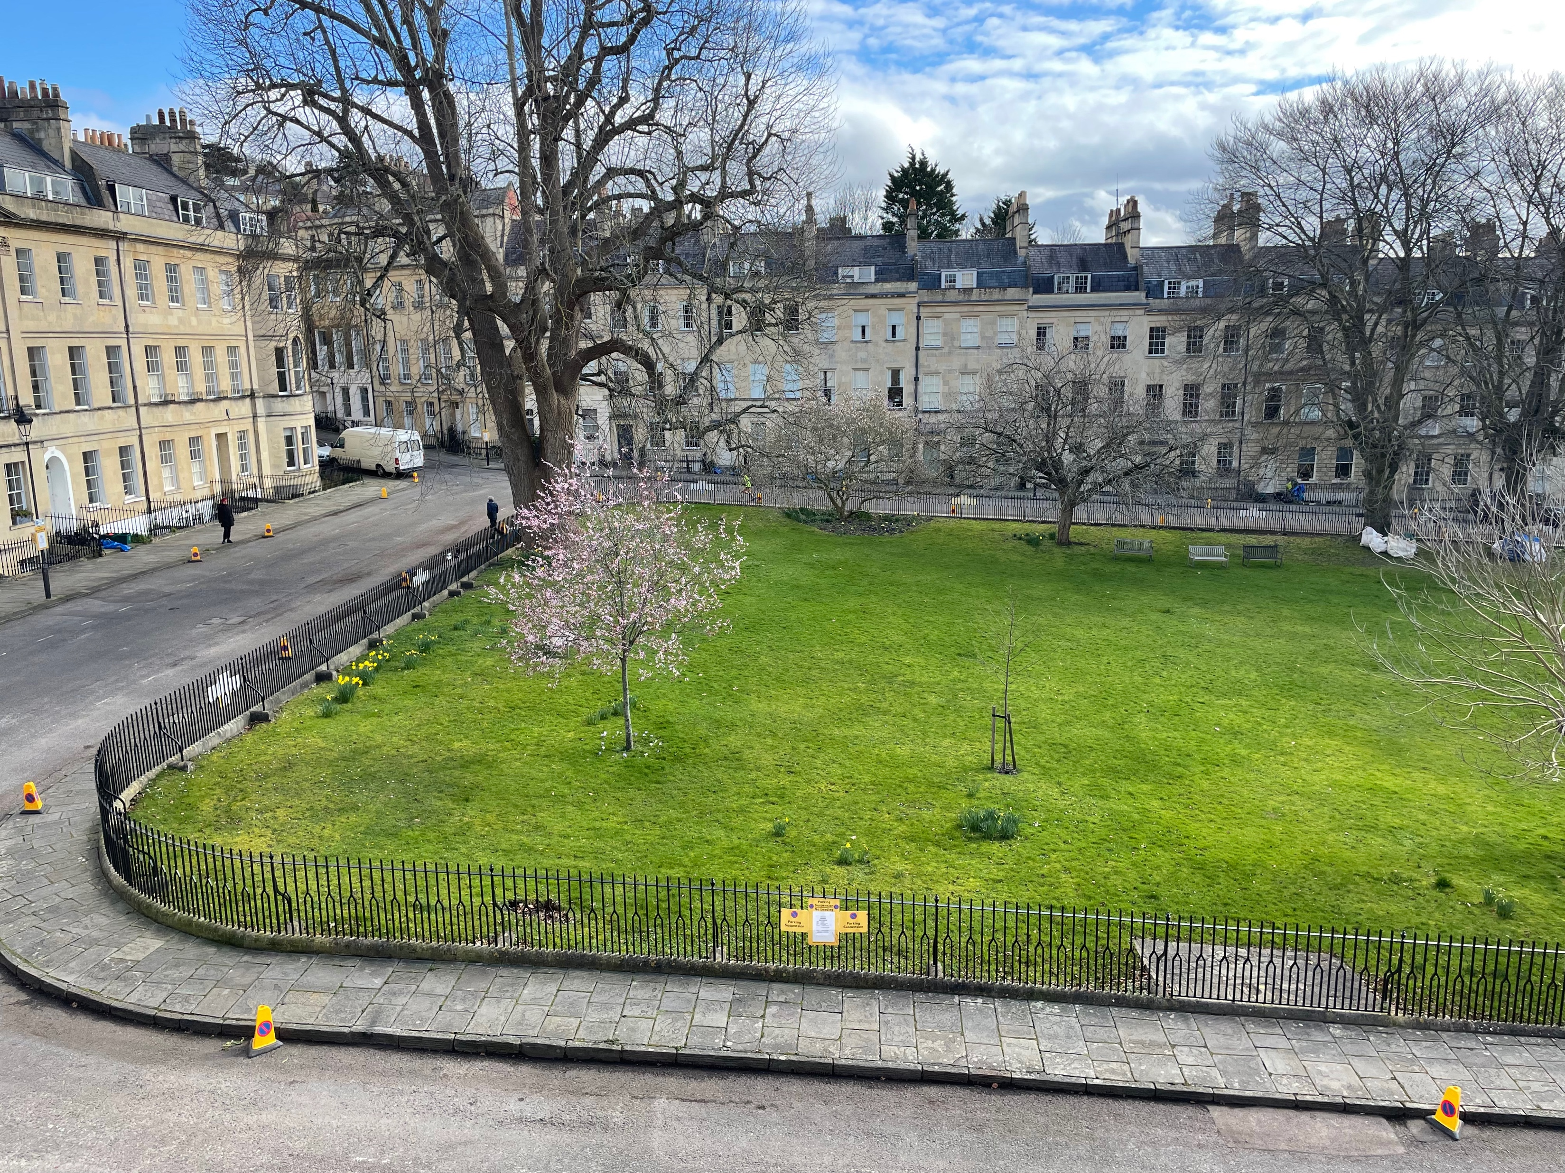
St James’s Square Update
Garden Update
I hope you enjoyed the snowdrops which have now finished flowering. New bulbs which should start flowering later in the month are wild Tulips, Star of Bethlehem, Snakeshead, Fritillaries and Chionodoxa. I can see the stems of most of them so I hope they will be successful and flourish in their new home.
Vicky Clarke – Director Garden & Trees
Post Storm Clean Up
Thank you to the residents who came out and helped clear the garden following the recent stormy weather. It was great to see such a good turn out and the garden is now looking much tidier as a result! Thank you also to those residents and children who couldn’t make it on the clean up day but came out earlier in the week to help.
Parking suspension and cleansing of St James’s Square
A huge thank you to all residents and neighbours who moved their cars on Thursday 10th March to allow the Council to undertake a full cleansing of the Square roads and drains. We think everyone will agree, the Square looked very different “car-free” and what a fantastic job the Council’s cleansing team did – the Square has never looked better! We appreciate that we probably cannot expect to have this done every year and it would be great if, next Autumn, residents can try to help clear leaves around their own properties (and opposite their houses on the garden side) on a regular basis and come out for our regular litter picks and leaf clearance events.
Liveable Neighbourhoods Planning & Hotel Valet Parking
Liveable Neighbourhoods
Following the latest Liveable Neighbourhoods(LN) consultation in late 2021, the Council will commence the next stage in its LN planning this month.
Four schemes, including nearby Royal Victoria Park (together with Cork Street/Tennyson Road), have been identified as having strong support and very straightforward to implement and, as such, the Council will move ahead to trial schemes and then consult. For Royal Victoria Park this will mean trialing vehicle access restrictions for some entrances to eliminate through traffic from the park.
For the remaining schemes that have been shortlisted, including the Circus area, Marlborough Buildings and lower Lansdown scheme, the next stage will involve a process of “co-design” with local communities.
As such, we have been invited to work with officers, our ward councillors, neighbouring residents’ associations and other stakeholders to help co-design a LN scheme for our area. We are especially keen to ensure that any proposed scheme addresses rat-running (especially with the displacement of traffic that our area has received from the Queen Square traffic light system) and calms traffic in our neighbourhood, but importantly, does not displace traffic from one residential street to another. Following the co-design stage, schemes will be put out to another consultation before it is decided which ones will proceed to trial implementation. We will keep residents advised on this as it develops.
Hotel Valet Parking
Changes to on-street parking permits and new parking charges came into effect across Bath on Thursday, 6th January. As part of these changes, hotels located in Central Zone are required to valet park guests’ cars at Council owned long-stay carparks rather than taking up on-street parking spaces. While these new rules should now mean that the Royal Crescent Hotel should no longer be valet parking its guests’ cars in St James’s Square, disappointingly, this has not been the case. The hotel managed to renew parking permits in both Central Zone (using its front door address) and Zone 7 (using its back door address) under the old scheme. The Council is looking into this, and we expect to hear shortly as to whether this Hotel should have been able to renew these permits in this way. We are extremely hopeful that the permits for Zone 7 in particular, will be rescinded.
St James’s Square Bath Limited : info@sjsbath.co.uk : www.sjsbath.co.uk

